Slide 1
CSTE 3207
Session: 2020-21

Slide 2
Optical Fiber Communication

Slide 3
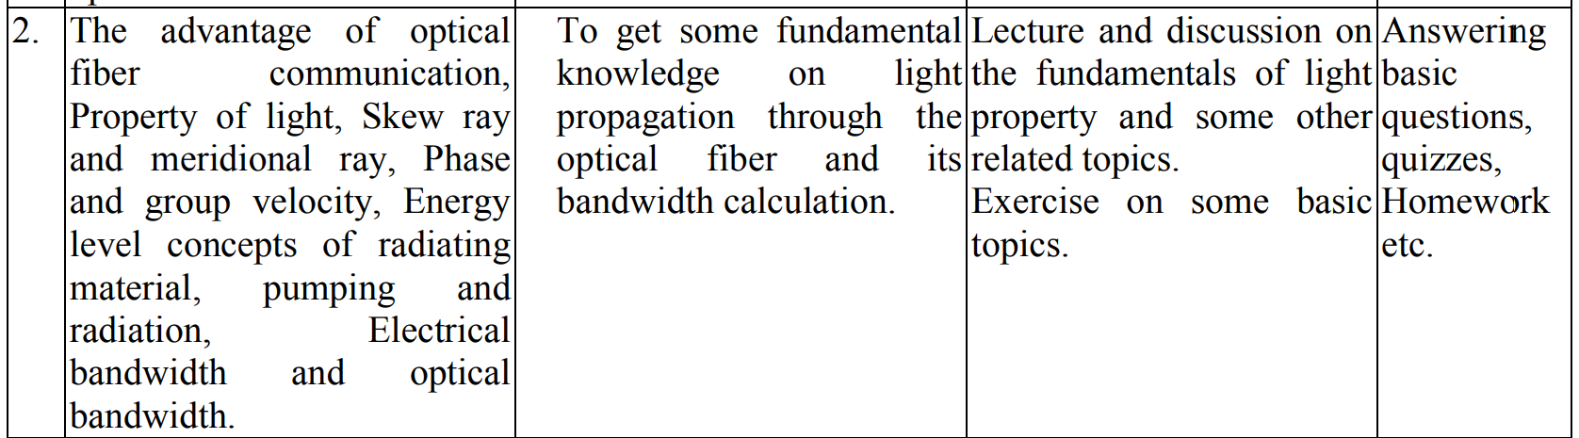

Slide 4
Outline
Advantages of optical fiber communication
Property of light
Skew ray and meridional ray
Phase and group velocity
Energy level concepts of radiating material
Pumping and radiation
Electrical bandwidth and optical bandwidth.

Slide 5
Advantages of Optical Fiber Communication

Slide 6
Advantages
Enormous potential BW
Small size and weight
Electrical isolation
Immunity to interference and crosstalk
Signal security
Low transmission loss
Ruggedness and flexibility
System reliability and ease of maintenance
Potential low cost

Slide 7
Property of Light

Slide 8
Substances shows the various properties of light
Transparent
Translucent
Opaque

Slide 9
Properties of Light
Reflection of light
Refraction of light
Diffusion of light
Absorption of light

Slide 10
Transmission/propagation of light through optical fiber

Slide 11
Basic optical-material properties
Index of refraction/ refractive index (n)
Ratio of the speed of light in vacuum to the speed of light in the material itself called Index of refraction. n=c/v
n for glass= 1.5
n for air= 1

Slide 12
Theory describing the propagation of light
through optical fiber
Ray theory
Mode theory
Geometrical Optics Approach
EM wave/ wave representation Approach
Describe light acceptance and guiding properties (reflection, refraction)
Describe absorption, attenuation, dispersion of OF

Slide 13
Theory describing the propagation of light
through optical fiber
Ray theory
Meridional Ray
Skew Ray
Pass through the axis of OF
Without passing through (or crossing) the center axis of the OF
Acceptance angle smaller
Acceptance angle larger

Slide 14
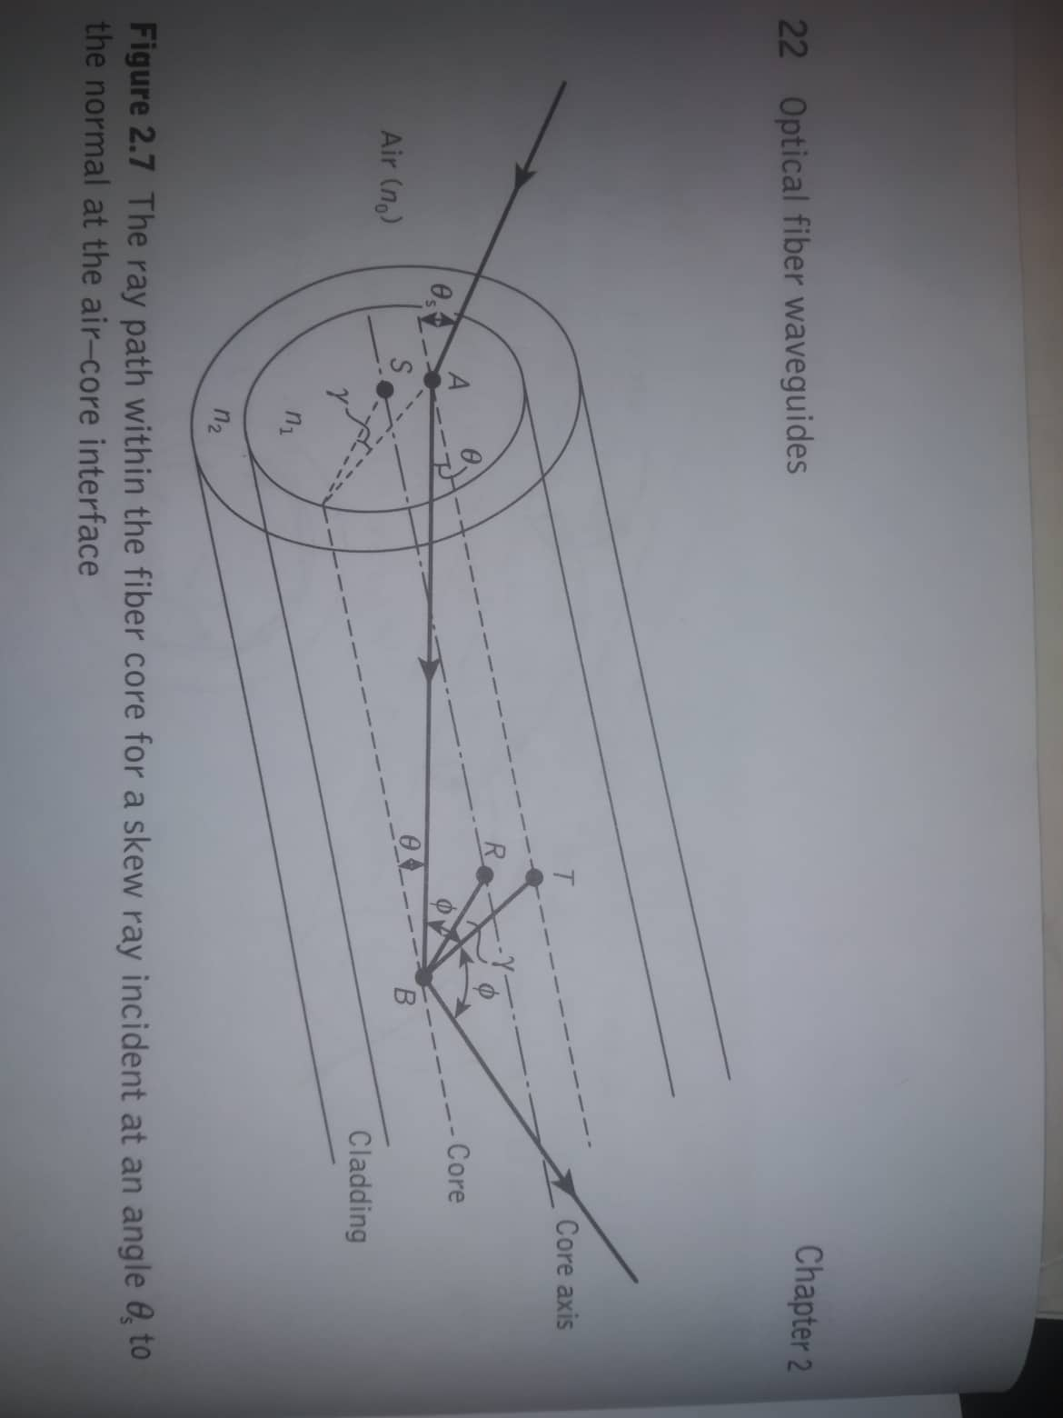
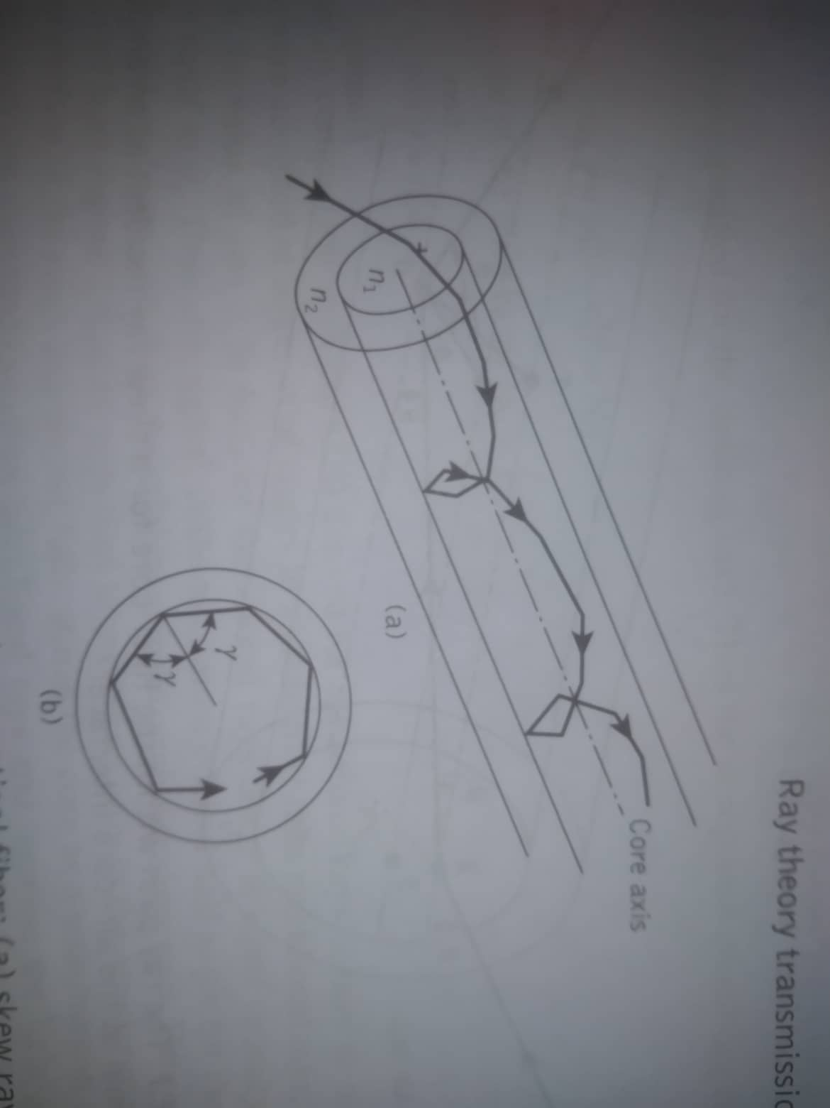
Skew ray

Slide 15
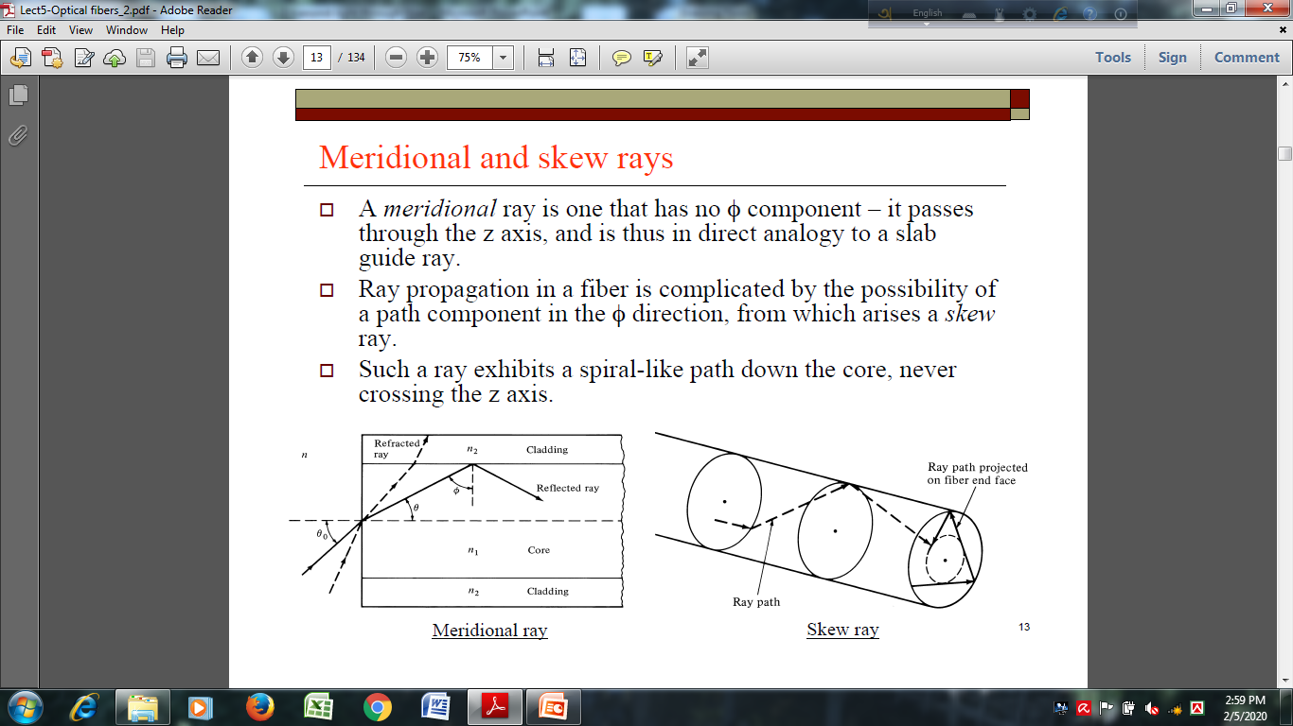
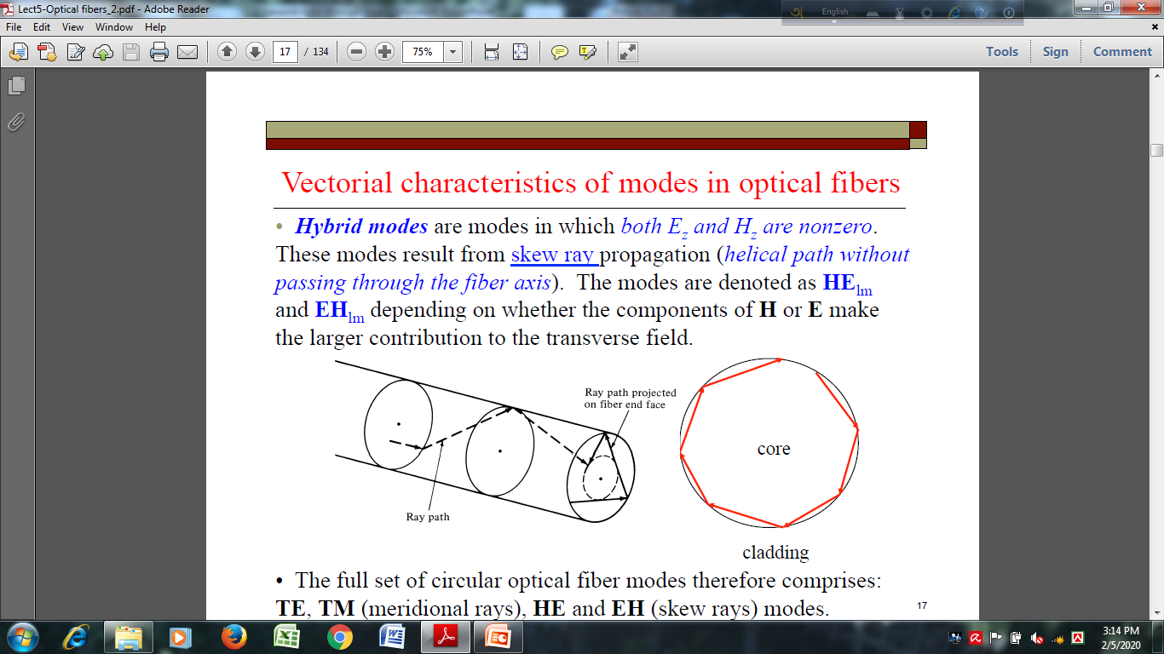
Meridional and Skew Ray

Slide 16
Phase and Group Velocity

Slide 17
Phase and Group Velocity
In vacuum, the phase velocity is c = 299 792 458 m/s, independent of the optical frequency, and equals the group velocity.
In a medium, the phase velocity is typically smaller by a factor n, called the refractive index, which is frequency-dependent (example: chromatic dispersion). In the visible spectral region, typical transparent crystals and optical glasses have refractive indices between 1.4 and 2.8.
The phase velocity is usually considered for plane waves, where the wavefronts are simply moving in a direction perpendicular to their orientation. The term wave velocity is vague; it may refer to phase velocity or group velocity, or possibly mean something else.

Slide 18
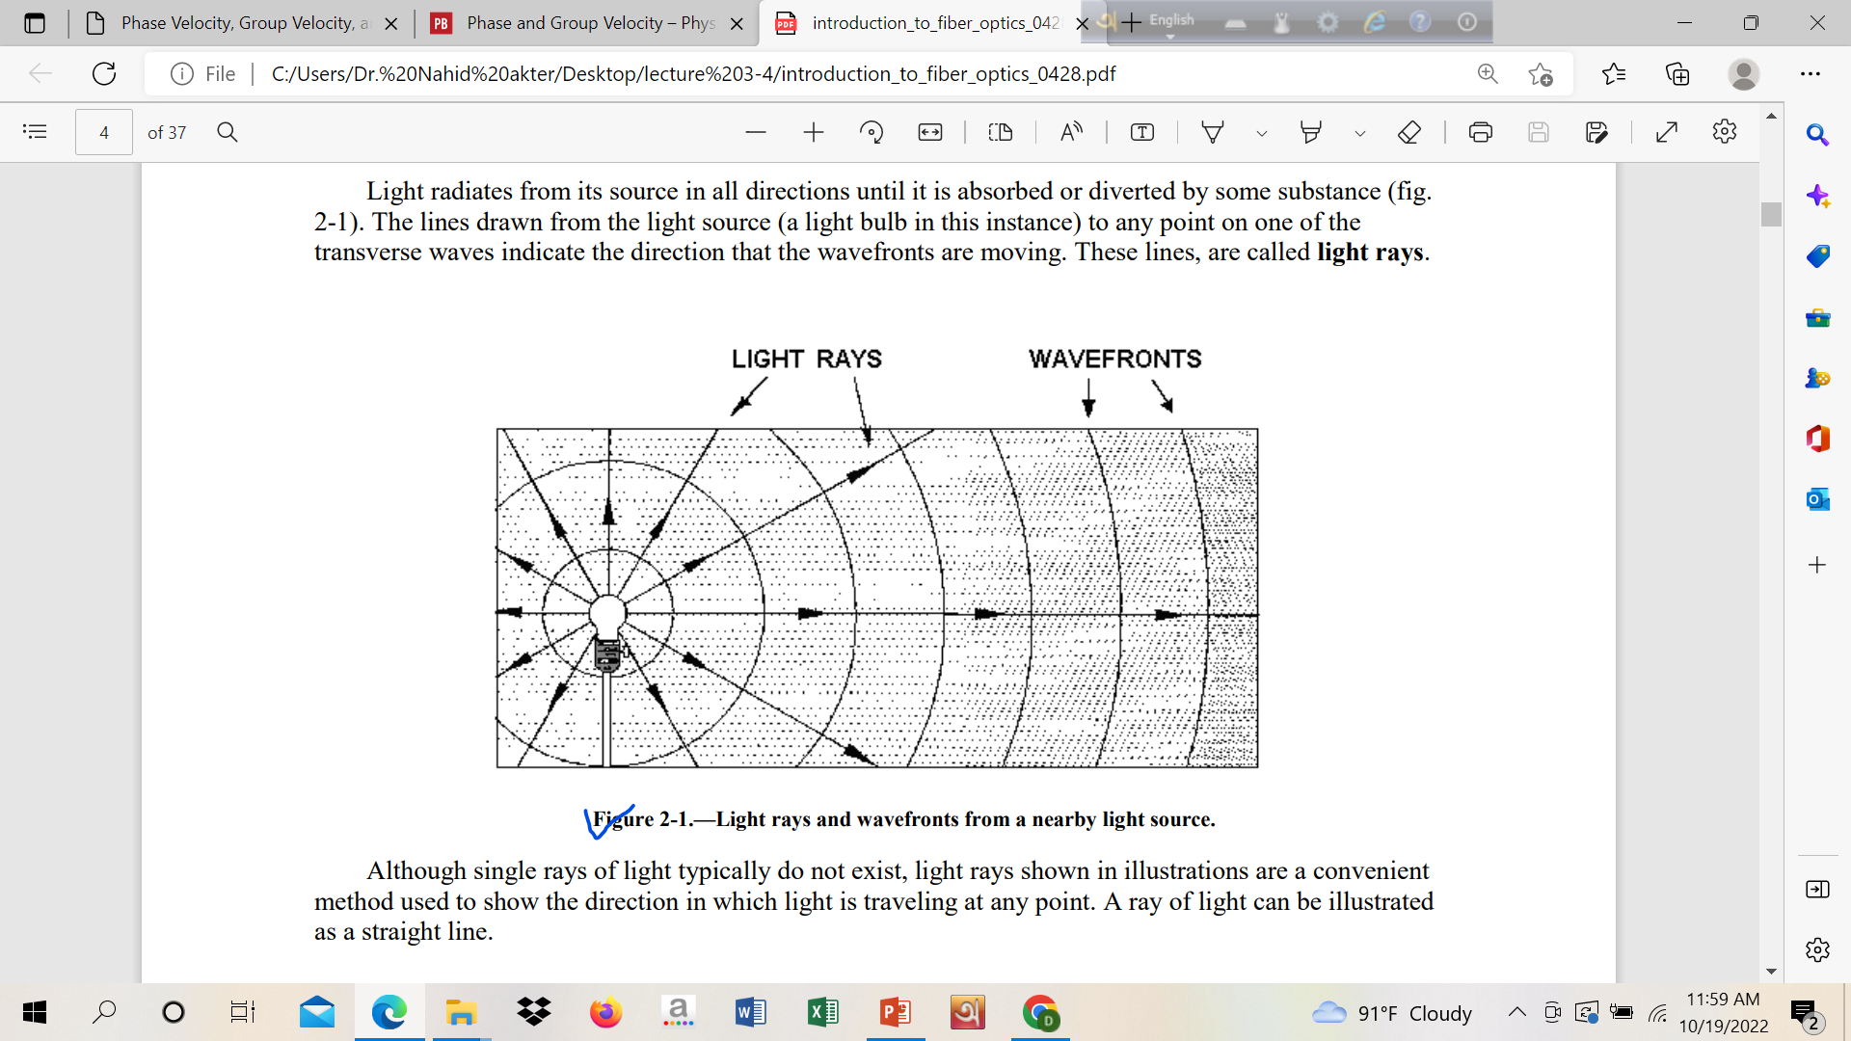
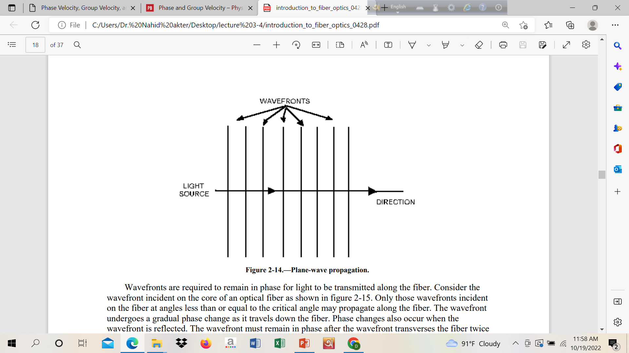

Slide 19
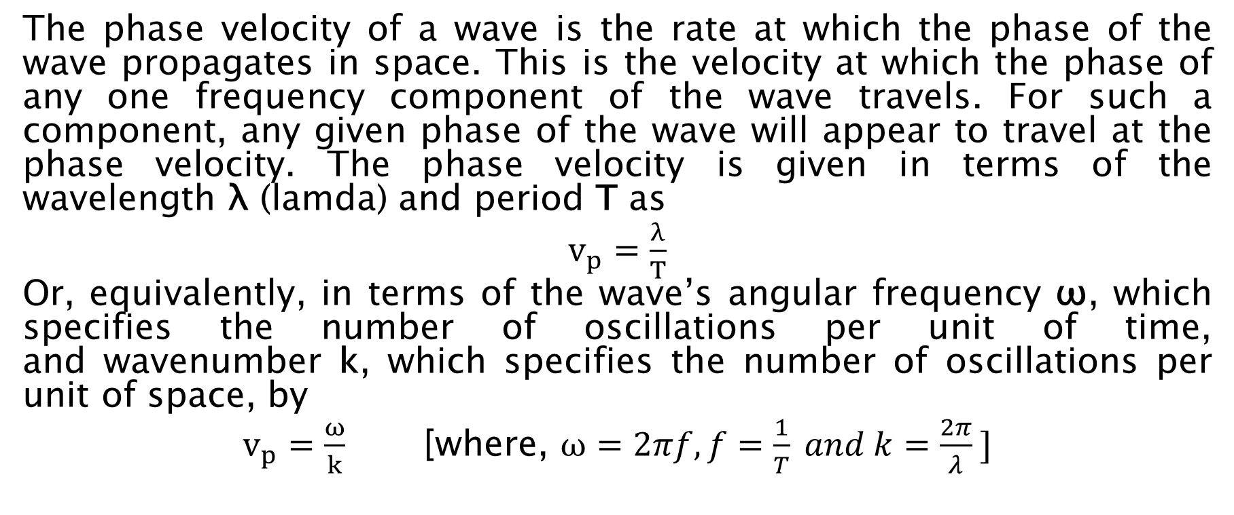
Phase Velocity
The phase velocity of a wave is the rate at which the phase of the wave propagates in space. This is the velocity at which the phase of any one frequency component of the wave travels. For such a component, any given phase of the wave will appear to travel at the phase velocity. The phase velocity is given in terms of the wavelength λ (lamda) and period T as
$v_{p}=\frac{λ}{T}$
Or, equivalently, in terms of the wave’s angular frequency ω, which specifies the number of oscillations per unit of time, and wavenumber k, which specifies the number of oscillations per unit of space, by
$v_{p}=\frac{ω}{k}$ [where, $ω=2πf, f=\frac{1}{T} and k=\frac{2π}{λ} ]$

Slide 20
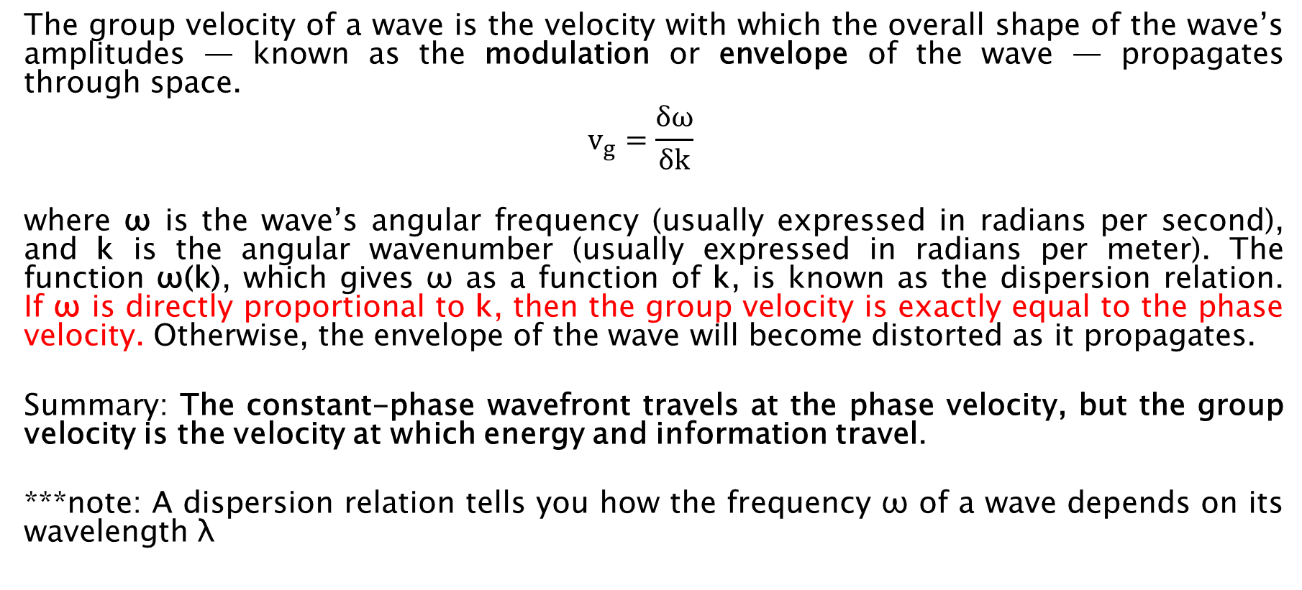
Group Velocity
The group velocity of a wave is the velocity with which the overall shape of the wave’s amplitudes — known as the modulation or envelope of the wave — propagates through space.
$$v_{g}=\frac{δω}{δk}$$
where ω is the wave’s angular frequency (usually expressed in radians per second), and k is the angular wavenumber (usually expressed in radians per meter). The function ω(k), which gives ω as a function of k, is known as the dispersion relation. If ω is directly proportional to k, then the group velocity is exactly equal to the phase velocity. Otherwise, the envelope of the wave will become distorted as it propagates.
Summary: The constant-phase wavefront travels at the phase velocity, but the group velocity is the velocity at which energy and information travel.
***note: A dispersion relation tells you how the frequency ω of a wave depends on its wavelength λ

Slide 21
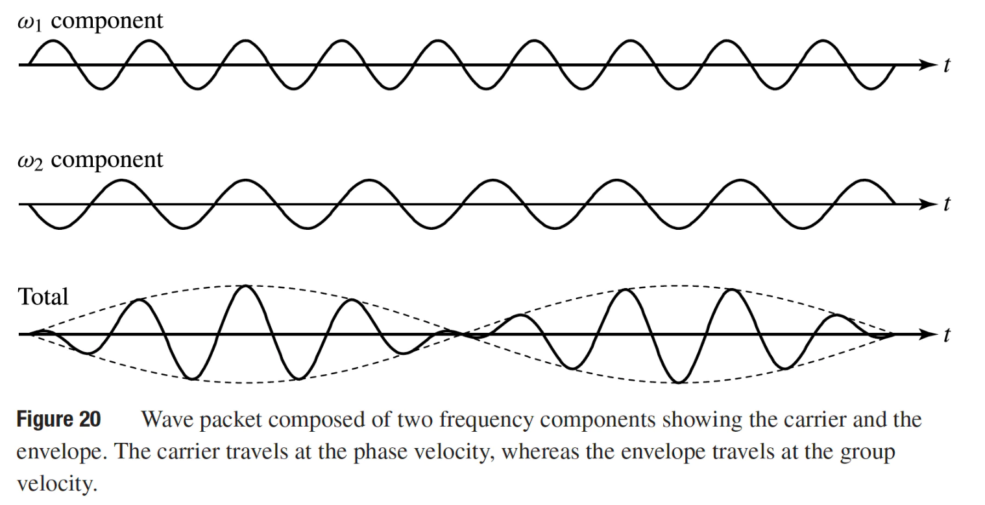
Phase and Group Velocity

Slide 22
Energy level concepts of radiating material

Slide 23


Slide 24
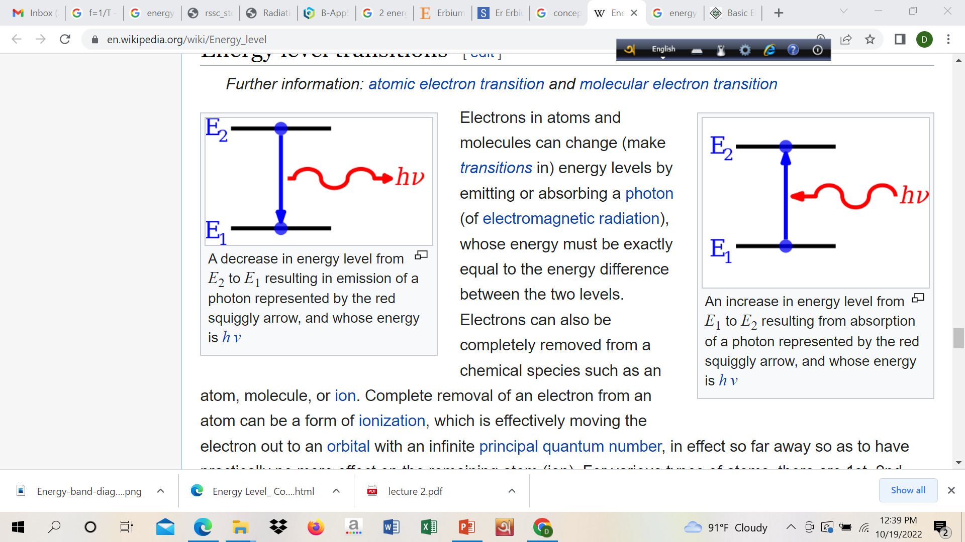

Slide 25
Electrical Bandwidth vs Optical Bandwidth.

Slide 26
Electrical Bandwidth vs Optical Bandwidth.
The optical bandwidth is higher than the corresponding electrical bandwidth on a frequency response curve. This is simply due to the fact that electrical bandwidth is that frequency at which the voltage gain falls to 0.707 times it's midband value which is generally considered to be -3dB point. Optical bandwidth is defined as that frequency at which the optical power gain falls to 0.5 of its midband value.
So, optical bandwidth is higher than the electrical bandwidth defined on the same frequency response curve.
[***see amplifier/filter frequency response (gain vs frequency curve)]

Slide 27
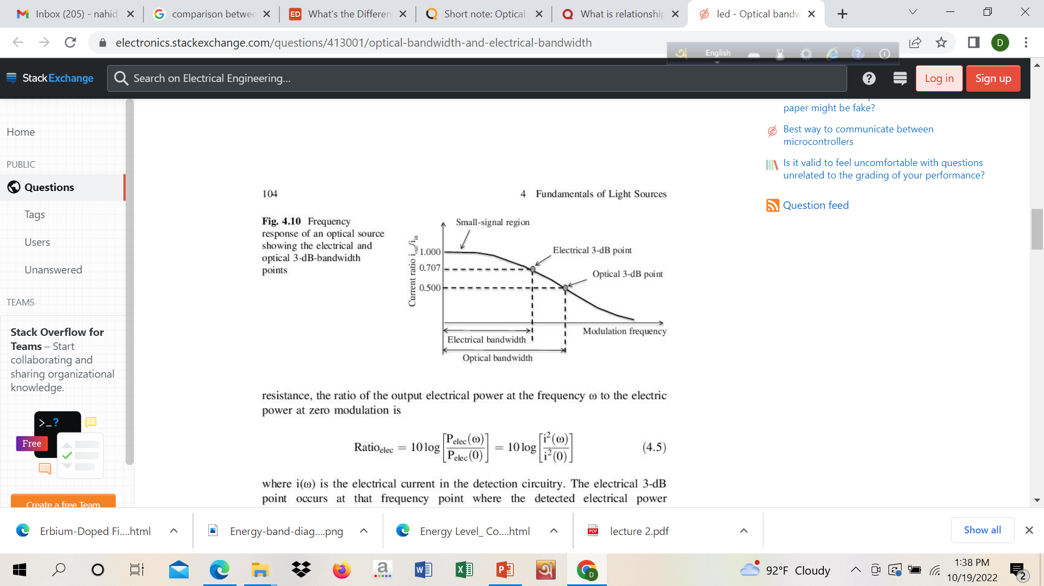

Slide 28
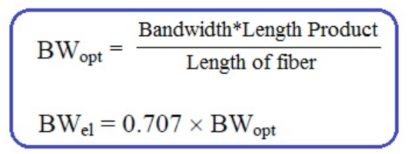
Electrical Bandwidth vs Optical Bandwidth.
Electrical Bandwidth: It is defined as frequency at which ratio of current output with current input drops to value of 0.707.
Optical Bandwidth: It is the frequency at which ratio of power output with power input drops to the value of 0.5.
Electical BW= 1/√2 * optical BW.

Slide 29
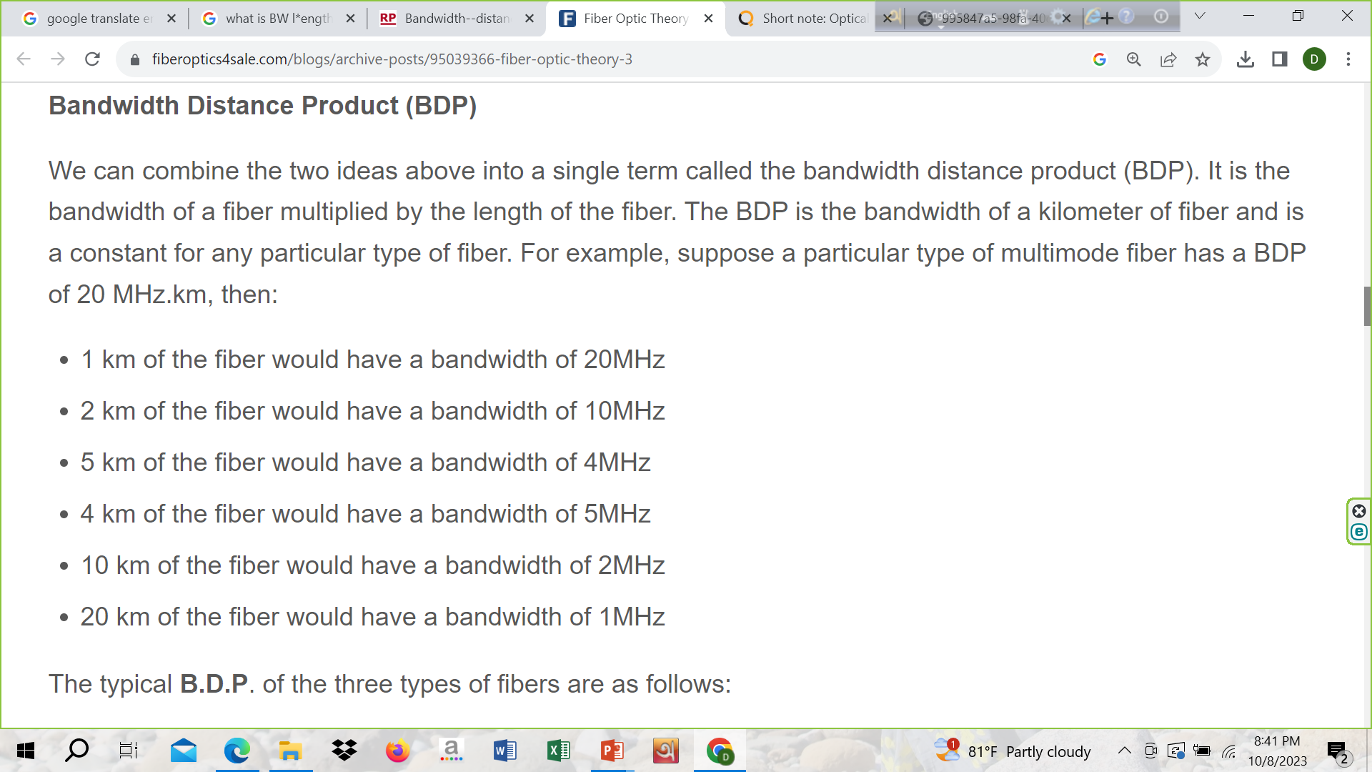

Slide 30
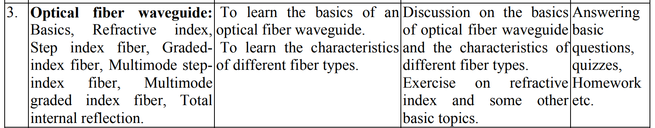

Slide 31
Relation between Frequency, Energy & Wavelength

Slide 32
Relation between Frequency, Energy & Wavelength
EM wave ranges with respect to frequency, wavelength and energy presents in EM spectrum. Frequency is directly proportional to energy and wavelength is inversely proportional to energy. For example: Compare between visible light and radio waves. Energy is smaller for radio waves.

Slide 33
Relation between Frequency, Energy & Wavelength
Speed of EM wave: speed in vacuum 3*10⁸ m/s (for every EM wave speed is constant). That’s why speed is same for visible and radio wave (but energy is different due to frequency / wavelength).

Slide 34
Refractive Index
When light transfers from one medium to another light changes by a constant number (times) call refractive index. Example:1.65 refractive index means 1.65 times decrease than vacuum or air.

Slide 35
Optical Fiber
Optical fibers are circular dielectric wave-guides that can transport optical energy and information. They have a central core surrounded by a concentric cladding with slightly lower refractive index. This difference in refractive indices allows the fiber to perform Total Internal Reflection inside the fiber and propagate light through its length.

Slide 36
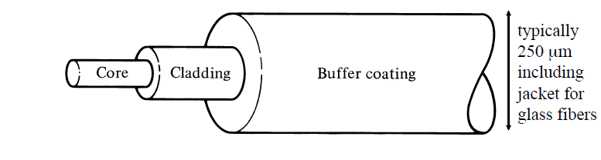
Optical Fiber Structure
A typical bare fiber consists of a core, a cladding and a polymer jacket (buffer coating). The polymer coating is the first line of mechanical protection. The coating also reduces the internal reflection at the cladding so light is only guided by the core.

